Slide 1
Transitioning from the 11th grade PSAT to:
REBECCA MASON
PRESENTER
SCOREMORE TEST PREP
443 813-1301

Slide 2
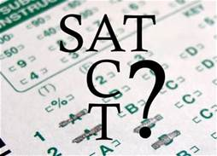
SAT
Designed to be an aptitude test-which tests reasoning. Questions are evidence based with emphasis on multi-step problem
Accepted by ALL college in US.
ACT
Designed to be an achievement test- which assesses skills learned in school. Questions are straight forward & less difficult to decipher.
Accepted by ALL colleges in US.

Slide 3
SAT STRUCTURAL DIFFERENCES ACT
Each section has a score range from 200-800
SAT questions get more difficult as
they progress in math area (only)
No penalty for incorrect answers
Composite SAT score is the sum of the two section scores. Report also gives national percentiles which compares your scores with national scores
Each section range 1- 36 points
Question difficulty level is more consistent on ACT
No penalty for incorrect answers
Composite ACT score is the average of student’s scores on the 4 sections. Test also gives national percentiles.

Slide 4
SAT Section Overviews ACT
Reading: 52 questions-65 minutes ( 1 minute 15 seconds)
Writing: 44 question-35 minutes ( 47 seconds per question)
Math (No calculator):20 questions-25 minutes ( 1 minute 15 seconds)
Math (calculator friendly): 38 questions-55 minutes ( 1 minute26 seconds)
154 Questions- 3 hours
Optional essay: 50 Minutes- Essay requires students to read a 650 word passage
Reading: 40 questions- 35 minutes (52 seconds per question
English (grammar): 75 questions- 45 minutes
( 36 seconds per question)
Math: 60 questions- 60 minutes ( 1 minute per question)
Science: 40 questions-35 minutes ( 52.5 seconds per question)
215 Questions-2 hours 55 minutes
Optional essay: 40 minutes- Essay-describes a social issue & provides 3 different views- very little reading

Slide 5
SAT Reading Section ACT
52 questions= 65 minutes
“Twofer one “ questions
Emphasis on commonly used vocab words
Answer choices more convoluted
Integrated charts & graphs
40 questions=35 minutes
No “Twofer one” questions
Fewer vocab words- more content based questions
Many one word or short phrase answers
No charts & graphs

Slide 6
SAT Writing-language ACT( English)
44 questions=35 minutes
(writing/language)
Easiest section to repair
Added to the reading score only for total 1 R/W/L score.
Charts or graphs
75 questions= 45 minutes
(English)
Easiest section to repair
Averaged with the R/M/S scores for 1 composite score
No charts or graphs
More emphasis on Punctuation

Slide 7
SAT Math ACT
Two math sections:
55 minute section=calculator allowed
20 minute section= calculator NOT allowed
13 Grid-in questions
Problem solving, data analysis, algebra 1+2, geometry and trigonometry. Formulas provided
4 answer choices
One 60 minute Math section=
calculator allowed
NO Grid-ins ( student produced responses) phew!
Questions are more straight forward
Algebra 1+2, geometry, trigonometry. No formulas provided
5 answer choices

Slide 8
SAT Science ACT
Charts & graphs are spread out throughout all sections
One reading passage is a technical and detailed natural science passage
40 questions: 35 minutes
Data analysis warehoused on one compartmentalized science section only
Approximately 3-4 questions require basic science knowledge

Slide 9
SAT ESSAY ACT
Essay is optional- maybe!
Essay written at the end of SAT
50 minutes=length
Extended passage ( 650-750 words) is central focus of essay
Prompt remains the same but reading passage changes
Essay requires writer to analyze the argument of author
Examples of reasoning & evidence come from passage
Two readers
3 essay sub-scores ranging from 2-8: reading, analysis, writing. Essay score not combined with multiple choice SAT section.
Essay is optional-maybe!
Essay written at the end of ACT
40 minutes= length
Writer provided with 3 perspectives on a topic regarding a social issue
Writers must consider each perspective offered & write a clear essay that evaluates each perspective, states their own perspective & explains the relationship between their views & the 3 presented
Two readers:2-12 score (assesses the writer’s ideas, support, organization and use of language)

Slide 10
As you read the passage below-
consider how the author uses:
Evidence, such as facts or examples, to build support.
Reasoning to develop ideas and to connect claims and evidence.
Stylistic or persuasive elements, such as word choice or appeals to emotion to add power to the ideas expressed.

Slide 11
THE Prompt
Write an essay in which you explain how the author builds an argument to persuade ( his/her) audience regarding the author’s claim. In your essay, analyze how the author uses one or more of the features listed above (or features of your own choice) to strengthen the logic & persuasiveness of (his/ her) argument. Be sure that your analysis focuses on the relevant features of the passage.
Your essay should not explain whether you agree with the author’s claims, but rather explain how the author builds an argument to persuade ( his/her) audience.

Slide 12
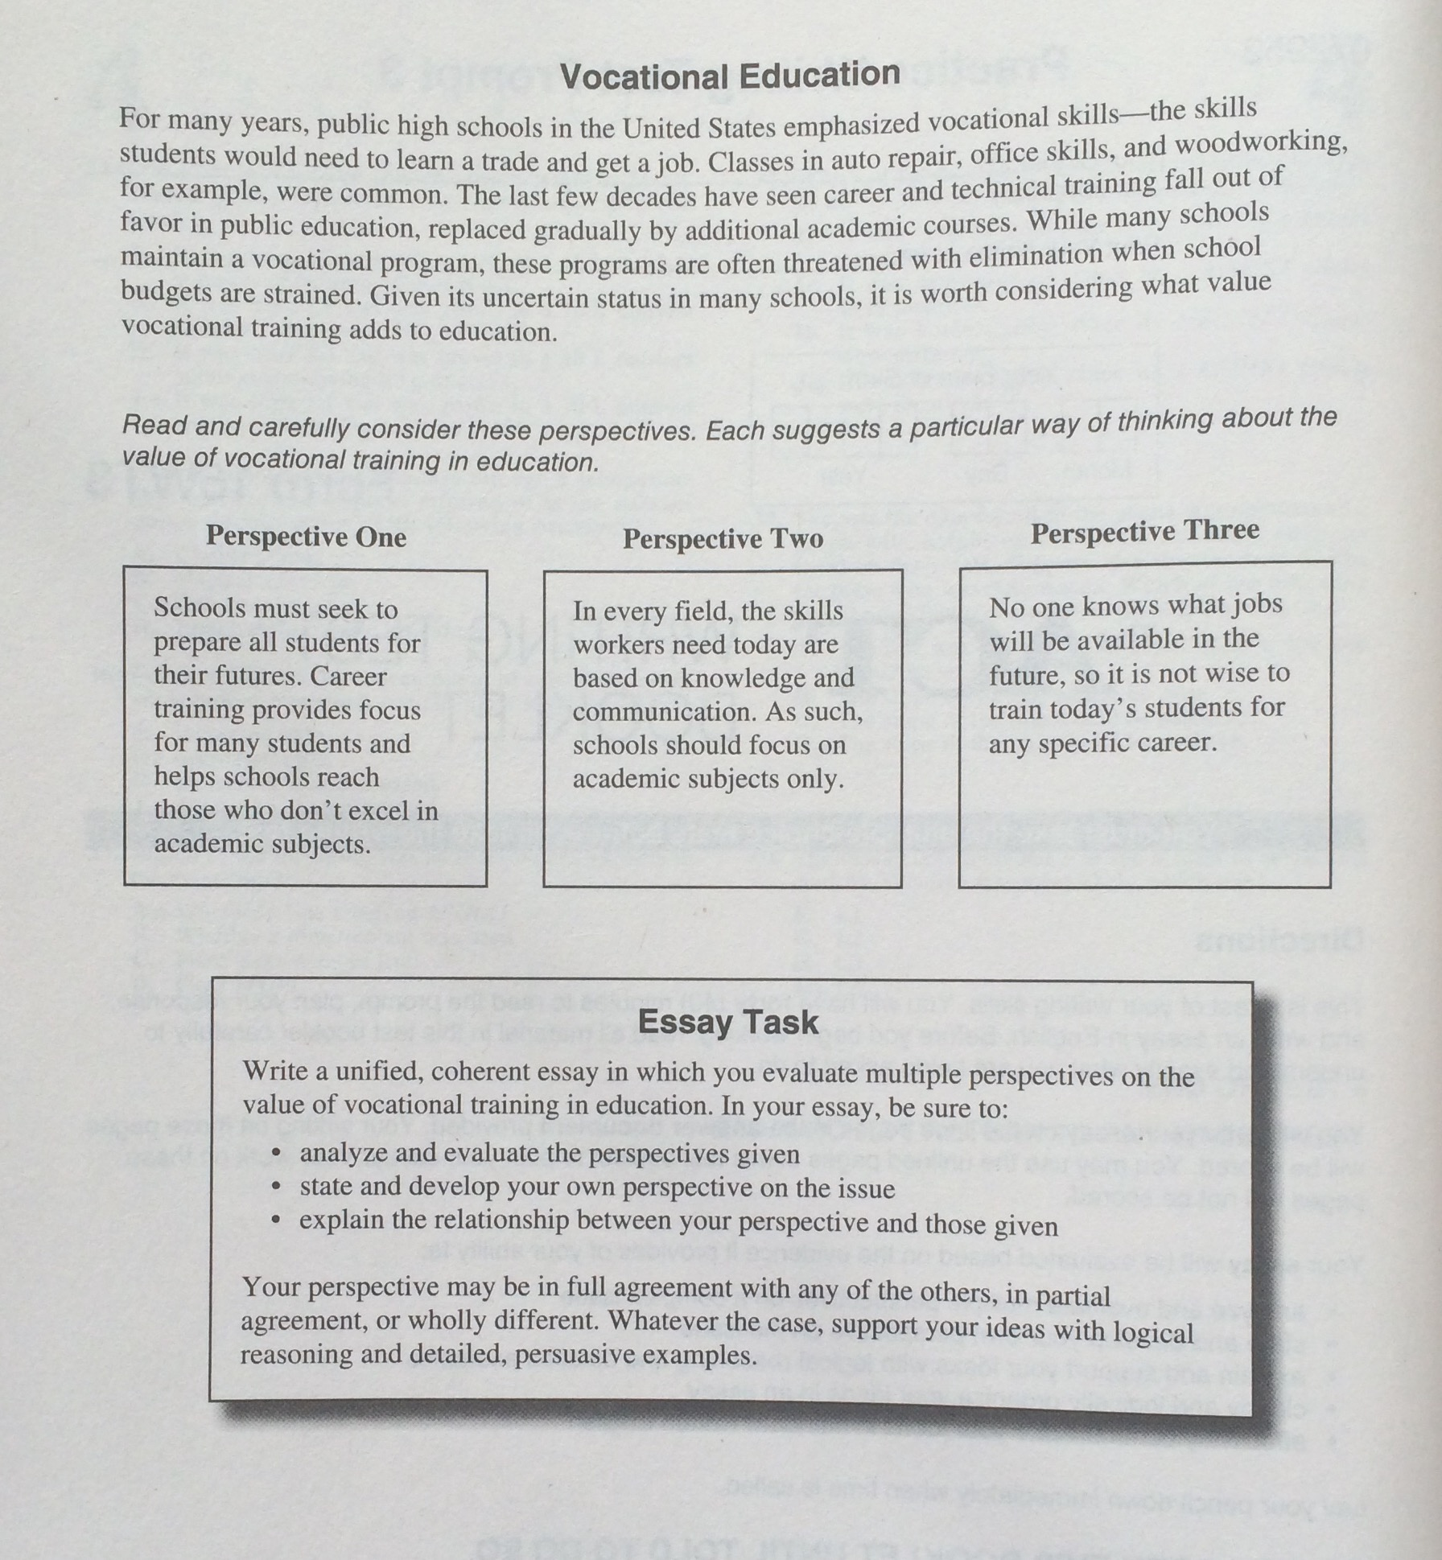

Slide 13
SAT ACT
Offered 7 times a year: March, May* June, August, October*, November & December ( question and answer)
Scores returned 20 days from test date
For more information go to www.collegeboard.org
Offered 6 times a year: February, April*, June*, September, October, December* ( test information release)
Scores returned 10 days from test date
For more information go to www.act.org

Slide 14
Colleges consider : GRADES, courses, rank, SAT’s, leadership, talents, recommendations
take challenging courses
get best grades possible
READ, READ for pleasure
write more
puzzles, brain-teasers
take practice PSAT, SAT & ACT
learn from score reports
review math
take good prep course
develop test-taking skills/ strategy

Slide 15
Super Scoring
What is it?
Who does this?
Will colleges see all previous
scores?
Not necessarily
You select test dates.
You cannot separate scores from any
particular test date. All go from one
date, or none goes.

Slide 16
Questions
Please feel free to contact us:
Martgagnon@aol.com
Rebecca Mason
443 813-1301

