Slide 1
LION’S NIGHT- Academic Planning for Current 9th Graders- Class of 2021
Lisa Veslany, Assistant Principal
Matt Mindel, School Counselor

Slide 2
Tonight’s Agenda:
Review of Graduation Requirements
Course Planning for 2018-2019

Slide 3
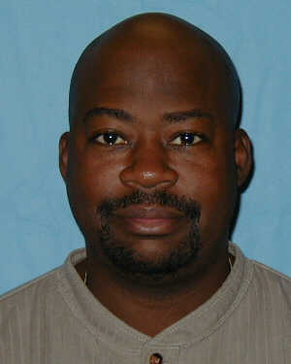
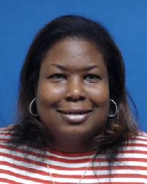
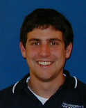
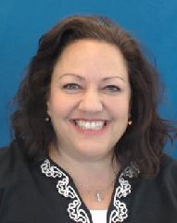
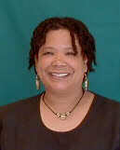
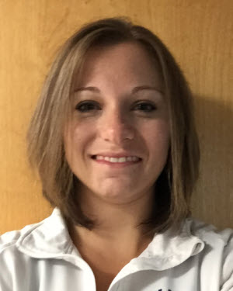
Howard High School Counselors
Mr. Glenn (A-B)
Mrs. Green-Lewis (C-G)
Mrs. Sutter (H-Mb)
Ms. Grieve (Mc-R)
Mrs. Snyder (S-Z)
Mr. Mindel (9th Grade A-K)
Ms. Valentine (9th Grade L-Z)

Slide 4
GRADUATION REQUIREMENTS
Credit Requirement
Service Learning
World of Work
High School Assessments

Slide 5
Credit Requirements
English | 4 credits |  | Health | 1/2 credit
Social Studies | 3 credits |  | Fine Arts | 1 credit
Mathematics* | 4 years |  | Technology Ed. | 1 credit
Science | 3 credits |  | Program Choice | 2 - 4 credits
Lifetime Fitness | 1/2 credit |  | Electives | 1 - 3 credits
Planning on College?
THREE or more years of a world language
Notes:
* Mention the 4 credit math requirement for University of Maryland system.

Slide 6
Program Choices
Advanced Technology
Career Academy Completer
World
Language
or
or
2 credits
2 credits
4 or 5 credits

Slide 7
Career Academy Programs
*Aerospace Engineering: PLTW
*Accounting
*Architectural Design
*Automotive Technology
*Biotechnology
Career and Research Development
Child Development
Computer Programming
*Construction
Culinary Science
*Cybersecurity Networking
Engineering: PLTW
*Finance
*Health Professions
*Homeland Security and Emergency Management
*Hotel and Restaurant Management
Marketing
*Systems and Project Engineering
Teacher Academy of Maryland
*Visual Communications
Many of these programs start 10th grade year, so this is the year to make decisions!
Notes:
Give out Career Academy Pamphlets

Slide 8
Early College Program pg.19
Cybersecurity
5-year cohort program pg.19 in catalog
Begins in 10th grade with CRD 1, CRD II at the Applied Research Lab
Allows students to earn a h.s. diploma, CompTIA Network +certification, CompTIA Security + certification, and an Associate of Arts (A.A.) degree in Cybersecurity from HCC.
See your School Counselor to review the 5-year program requirements.

Slide 9
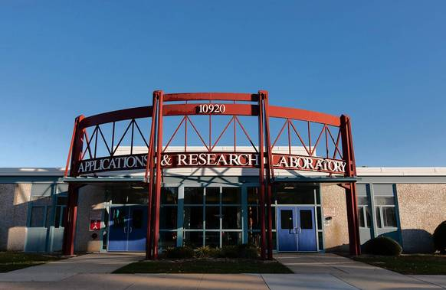
ARL Shadow Days
January 30, 31 and February 1
ARL Shadow Days
*Applications will be available in Student Services

Slide 10
Science
Maryland adopted new science standards in 2013.
These new standards, known as the Next Generation Science Standards (NGSS), are very different than past standards.
Beginning in school year 2017-18, a new high school assessment aligned to the new standards will be administered for the first time.
The revisions to the HCPSS high school program of studies in science are in support of the standards and changing accountability system.

Slide 11
Maryland Integrated Science Assessment (MISA)
NGSS aligned
Replaces Biology HSA
Online assessment
Taken after completing coursework in all 3 disciplines
Earth/Space science
Life science
Physical science
Notes:
MISA (Maryland Integrated Science Assessment) is the new standardized science assessment aligned to the NGSS. MISA will cover all science disciplines: Earth/Space science, Life science (biology), physical science (Chemistry & physics). MISA supersedes the Biology HSA.
Our goal is to help students be scientifically literate, rather than teaching them to pass a standardized test. Thus, MISA is not aligned to any specific course(s); it is to be taken after students have completed coursework in all three major science disciplines.
Students will participate in MISA during the year they complete their science graduation requirement. For most students, this means they will participate in MISA at the end of the eleventh grade as they complete their third science credit.
During 2016-17, only the following students in grades 9-12 will take the Biology HSA:
Students who are taking Biology for the 1st time this year (2016-17 school year), or
Students who already completed Biology, but have not yet passed the Biology HSA or have not successfully completed a Biology Bridge Project for academic validation (aka Bridge Project.)
The MISA will be phased in beginning in 2017-18. At that time, all students must participate in MISA if they have not yet met the Biology HSA graduation requirement.
However, MISA pass scores will not be a HS graduation requirement until 2020-21. This year’s 8th graders (graduating class of 2021) will be the 1st cohort to be accountable on the MISA.
We do not expect that anyone will have to take both HSA and MISA.

Slide 12
MISA Timeline
2016-2017: Final year HSA Biology
2017-2018: Maryland begins MISA pilot
2018-2019: MISA pilot test
2019-2020: MISA graduation requirement
Notes:
Summary of MISA roll out in high schools.
Note: Students enrolled in Biology during the 2016-17 school year must participate in the Biology HSA (or complete a Biology Bridge Project) for graduation. 2016-17 will be the last year the Biology HSA is administered.
FY18 and FY19 are “no fault” years for MISA. HCPSS students will first take MISA in FY19, but the 2020 graduating class will only be required to take the test (not to pass).
The Classes of 2021 (next year’s 9th graders) and beyond will be required to meet score minimums as a graduation requirement.
Pass scores will be set by the Maryland Dept. of Education.

Slide 13
H.S. Curriculum Changes
All students take courses in all 3 science disciplines
Earth/space science
Life science
Physical science
MISA after core courses completed
G/T and AP options in each discipline
Notes:
The NGSS-aligned, High School Science program of studies includes several significant changes from the previous program of studies. Specifically:
All students will take courses to provide learning in each of the 3 science disciplines, Earth/Space, Life, and Physical. This provides the core science knowledge across all disciplines that students will need to pass the MISA and for ongoing science learning.
All students will learn Earth science either through registering for Earth/Space Systems Science or through the G/T biology and chemistry courses where Earth/Space science concepts will be included.
All students will learn chemistry and physics either through registering for G/T chemistry and AP Physics or through the Advanced Physical Science course which will integrate concepts of the physical sciences (physics and chemistry).
Students take the MISA after successfully completing coursework in all 3 main disciplines. The test is taken in the year when students complete their 3rd disciplinary course. Most students will take MISA in Grade 11.
All students have opportunities to take additional enrichment courses once the core courses are completed.

Slide 14
H.S. Science Graduation Requirements
CORE LAB COURSES in each major discipline
Earth/Space science
Life science (biology)
Physical science (chemistry and physics)
MISA
Participation: All students who have not already passed Biology HSA
Pass score: Beginning with Class of 2021
Notes:
As a summary before examining course sequences, recall that all high school students must complete three laboratory science courses and must meet MISA science assessment participation/pass requirements to be eligible for graduation. (Exception: students who have already met the Biology HSA graduation requirement are exempt from MISA.)

Slide 15
Notes:
The course progression in science is flexible and designed for student success and opportunity. Grade 9 Students will select from 1 of 2 course choices: Earth and Space Systems Science or Biology G/T. The selection should be based on the student's interests, strengths and long-term goals in college and career.

Slide 16
Service Learning
75 hours of service which includes planning, action, and reflection.
Did you complete? Check report card or ask counselor
Don’t have the hours completed?
Consider taking Leadership in 11th or 12th!

Slide 17
WORLD OF WORK
Personal Essay & College Application
Cover Letter & Resume
Mock Interview
This requirement will completed through your English class during junior year.

Slide 18
High School Assessments/PARCC
PASS
American Government HSA
PASS
MISA
(MD Integrated Science Assessment)
PASS
English 10 PARCC
PASS
Algebra I PARCC

Slide 19
Weighted Grading Scale
Grade | Standard | Honors | GT/AP
A | 4.0 | 4.5 | 5.0
B | 3.0 | 3.5 | 4.0
C | 2.0 | 2.5 | 3.0
D | 1.0 | 1.0 | 1.0
E | 0 | 0 | 0
Weighted GPA is used for eligibility, honor roll and high school transcripts.

Slide 20
What is academic eligibility?
Allows participation in all voluntary extracurricular activities.
Must maintain a 2.0 grade point average
AND
no more than 1 failing grade for the marking period prior to the start of the activity.

Slide 21
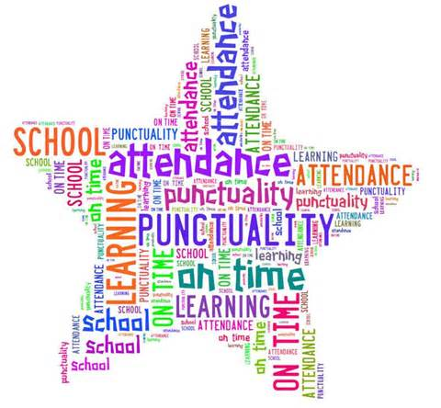
Attendance Policy
All students are expected to attend regularly in accordance with Maryland public school laws.
Any student with lawful or unlawful absences of more than 5% of the course may be considered for denial of credit.

Slide 22
http://www.hcpss.org/jumpstart/

Slide 25
COURSE REGISTRATION INFORMATION AND PROCEDURES

Slide 26
Scheduling Calendar
December 11-22: Core class teachers (English, math, science, social studies, and level 1 and 2 world language) post online recommendations in Synergy
January 8: Scheduling kick-off for grades 9-11, pd. 3 (homeroom)
January 10-19: Students enter remaining course requests, including alternates, in HCPSS Connect
January 9: Lion’s Night: Essential Academic Planning
January 10 (Wed) Elective Fair during Lunch Shifts
January 10-18 Teacher conversations with students
January 29-February 15: Course Registration Meetings with Counselors
Notes:
Talking point: course reg book, lesson early, and why we are here now

Slide 27
G/T Independent Research and Intern-Mentor Program
•G/T Research Program Information Night:
January 9th, 5:30pm, Howard High School Media Center
•Application Packets will be available at the Information Night, from Ms. Curtin (V130), in Student Services, and online starting December 19th
•Applications due :
Ms. Curtin in her classroom (V130) by January 31st
An interview is required for Intern/Mentor!
Sign-up when you drop off your application.
Register for 1 credit on Course Registration Forms
Course #GT-430-1 - An interview is required!!!

Slide 28
Howard Scholars Program
Any student who thinks that they will graduate with:
6 AP courses (4 must be in main content areas- Math, Social Studies, Science, English)
Have you completed a Howard Scholars Application?
11th Grade is the last year that this application can be completed.
Applications available in Student Services January 5th
Applications will be due: January 31st
Applications will not be accepted past the deadline

Slide 29
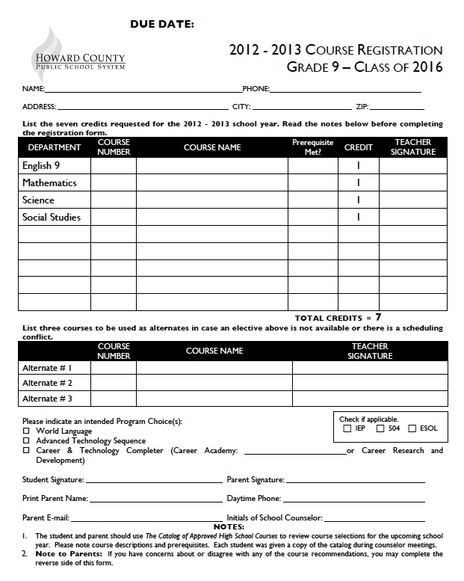
Course Requests will now be completed through HCPSS Connect

Slide 30
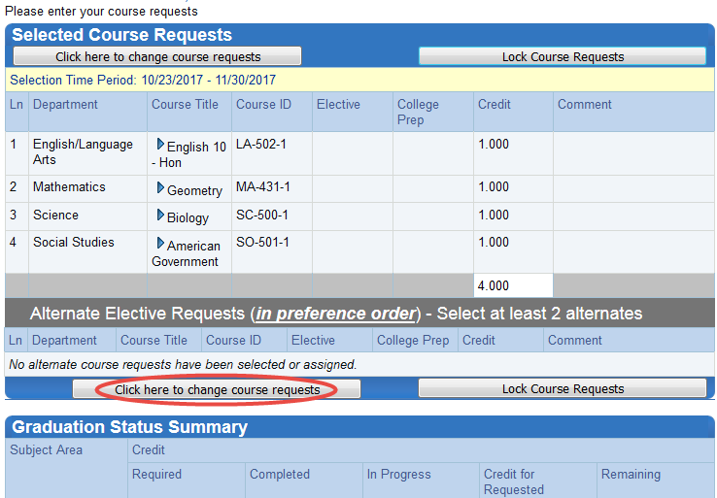
Students can see Core Course Recommendations and Graduation Requirements in HCPSS Connect

Slide 31
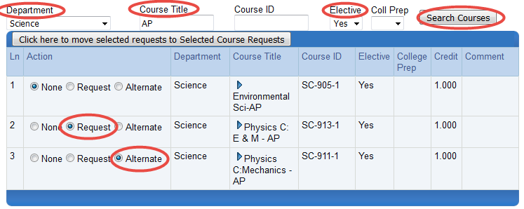
Students can search for courses by Department, by Course Title, or for just Electives
Students will select requests and alternates.

Slide 32
If you are having difficulty getting into HCPSS Connect:
See Leanne Peters
Stationed in Room N120 tonight
(across from Cafeteria)

Slide 33
Course Placement Review Form
If you and your parent would like to consider a different option than what was recommended, YOU AND A PARENT should talk with your teacher BEFORE completing this form.
Process after you submit a Course Placement Review Form:
Your school counselor and/or administration will follow up with you regarding:
Current placement and progress
Rigor and Balance

Slide 34
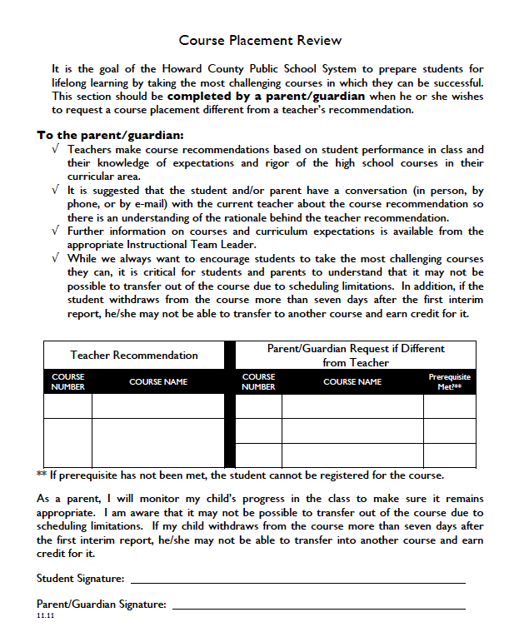

Slide 35
How to Make It Count
Explore Career Interests
SAT/ACT Prep Classes
Take Rigorous Courses
Develop Good Study Habits
4 Years of Core Academic Classes
3 or More Years of a Consecutive World Language

Slide 36
Courses for an 10th Grade Student
Core Subjects:
English 10
American Government
2nd year science class
2nd year math class
Other Possible Classes depending on student’s progress & goals:
Graduation Requirements- art or tech credit
SAT Prep
AP Offerings
World language or Completer Program
Career Academy
Explore an Interest

Slide 37
THINK: Challenge AND Balance
Don’t overload your schedule just because it “looks good”.
Think about academics in addition to extra-curricular activities and other commitments (job).
Highlight your strengths. Don’t feel like you need to take advanced courses in EVERY subject area.
Class sizes are FULL. Commit to the schedule you sign-up for.

Slide 38
PSAT to SAT
Free SAT Practice
www.khanacademy.org/sat

Slide 39
Remember- Naviance!
10th Grade
Fall: Career Interest Inventory
Spring: Connecting Careers to College Majors
11th Grade
Fall: College and Career Research: Future Planning
Winter: World of Work: Mock Interview
Spring: College Searching

Slide 40
Mid-Term Exams
Tues., January 23rd (Full Day) Period 1 Exam
Wed., January 24th ( 3 hour early dismissal) Period 2 & Period 3 exams
Thurs., January 25 (3 Hour Early Dismissal) Period 4A & Period 4B exams
Fri., January 26th (3 Hour Early Dismissal) Period 5 & Period 6 exams
No exams may be given to students before the scheduled dates for any reason.

Slide 41
Academic Interventions
Extended Day: Tuesdays
2:15-4:00pm. Tutoring in Math followed by Homework Club; Transportation is included for this specific program. Must complete an application.
National Math Honor Society: Wednesday
2:15 – 3:15pm; Ms. Robert’s room, A213
Student Tutoring: During all Lunch shifts: Room N120
Math and Science-Mondays and wednwsdays
Eglish and Social Studies- Tuesdays and Thursdays
Spanish and French- Fridays
Content Teacher Tutoring: arranged time with teacher
Lion’s Time: http://howardlionstime.com/login.php Wednesdays, 9:00am-9:30am

Slide 42
QUESTIONS??

